Slide 1
Preprocessing, spectral analysis and alignment
October 2024
Andrea Corrado

Slide 2
Outline
Recap of objectives so far
Signal preprocessing
Spectrum estimation
Signals alignment
Possible features of Rov Signals
Conclusions

Slide 3
Outline
Recap of objectives so far
Signal preprocessing
Spectrum estimation
Signals alignment
Possible features of Rov Signals
Conclusions

Slide 4
Recap of the objectives so far
So far, data has been explored to find out their inner characteristics.
Proprieties in time domain
Proprieties in frequency domain
But at least three problems were encountered:
Data require preprocessing
Spectral analysis is hard due to inner limits of methods
Data require alignment
Target 1 : building a population dataset
Target 0: Answer to:
How preprocess data?
How frequency characterise these signals?
How align data?

Slide 5
Outline
Recap of objectives so far
Signal preprocessing
Spectrum estimation
Signals alignment
Possible features of Rov Signals
Conclusions

Slide 6
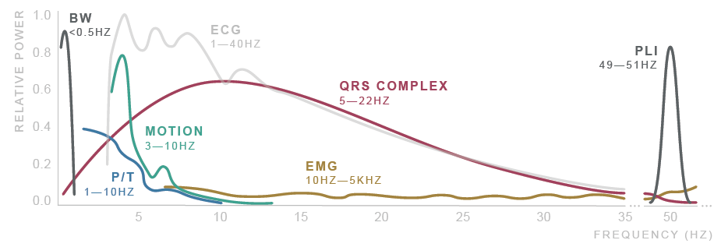
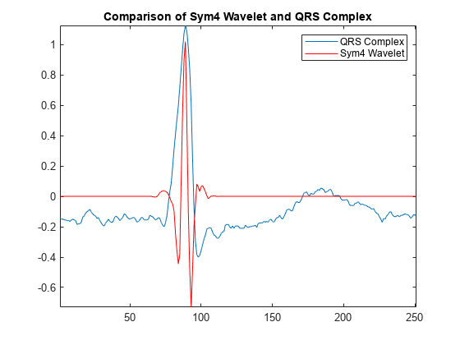
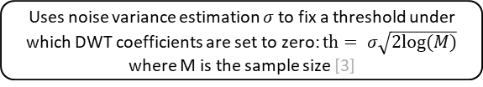
Signal preprocessing
ECG signals noisy and require to be preprocessed and filtered [1]
Noise sources: Physiological, Environmental, Artifacts, Electronic…
After literature research, the proposed filtering method [1,2] consists of:
Donoho thresholding [3] on discrete wavelet transform coefficients (DWT)
Shrink the coefficients related to, presumably, high frequency noise and low frequency noise
Followed by zero-phase band pass filtering
Improves the result eliminating residual noise
Original signal
DWT decomposition
Symlets 4 wavelet is used due to its good performances on ECG signals [2, 3]
Donoho soft thresholding
Uses noise variance estimation $σ$ to fix a threshold under which DWT coefficients are set to zero: $th= σ\sqrt{2log⁡(M)}$ where M is the sample size [3]
DWT reconstruction
Butterworth HP filter (order 6, cutoff at 0.5 Hz)
Butterworth LP filter (order 6, cutoff at 60 Hz)
1. Saraiva, João & Plácido da Silva, Hugo & Fred, Ana. (2022). Denoising and Artifact Removal of the Electrocardiogram, Electrodermal Activity and Accelerometery for Continuous Ambulatory Monitoring of Epileptic Seizures with Wearable Devices.
2. Singh, Brij N., and Arvind K. Tiwari. "Optimal selection of wavelet basis function applied to ECG signal denoising." Digital signal processing 16.3 (2006): 275-287.
3. Donoho, David L. "De-noising by soft-thresholding." IEEE transactions on information theory 41.3 (1995): 613-627.

Slide 7
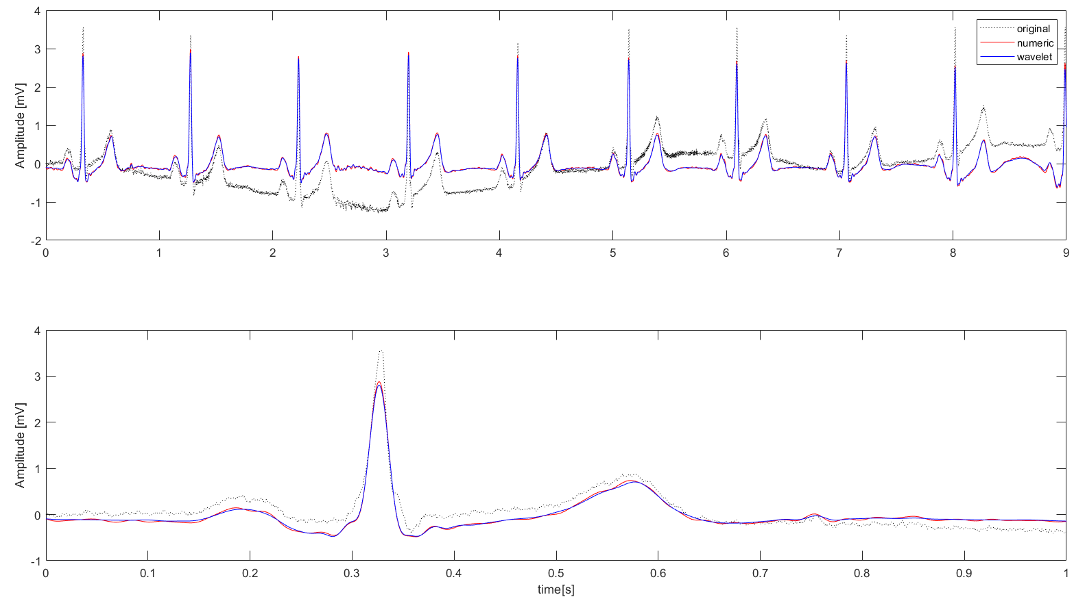
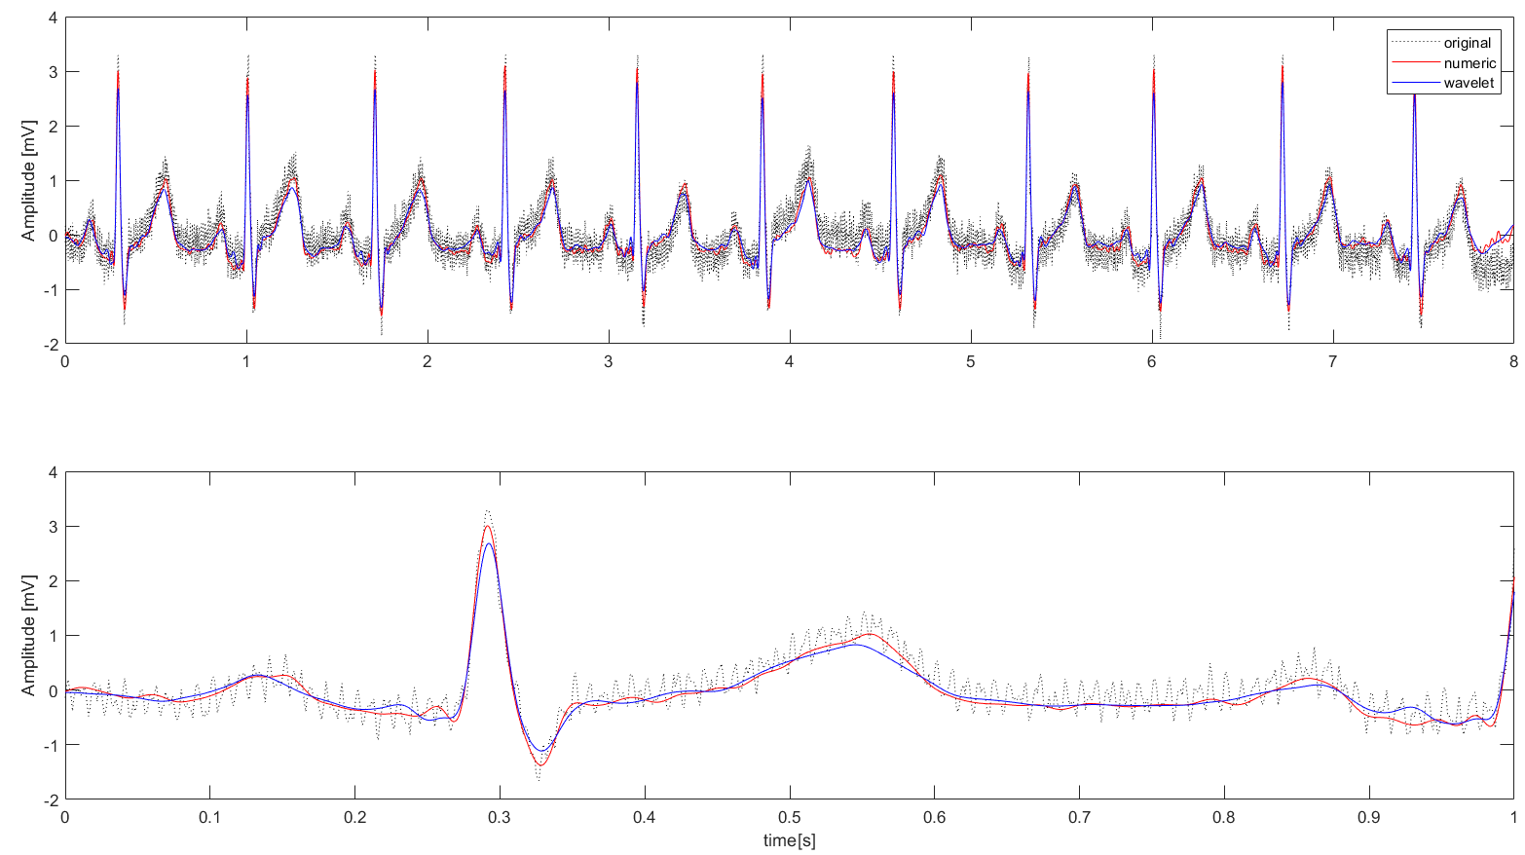
Preprocessing results: External data
The proposed filtering pipeline (blue line) has been tested on well-know external data (didactical) and compared with the same strategy without the DWT thresholding (red line) :
ECG 1: HF noise
ECG 2: LF noise
In conclusion, DWT thresholding combined with BP zero-phase filtering leads to good results.
Moreover, this strategy has other known advantages:
Higher performance even on other sources of noise [1]
Good performances on short signals [1,2]
1. Saraiva, João & Plácido da Silva, Hugo & Fred, Ana. (2022). Denoising and Artifact Removal of the Electrocardiogram, Electrodermal Activity and Accelerometery for Continuous Ambulatory Monitoring of Epileptic Seizures with Wearable Devices.
2. Singh, Brij N., and Arvind K. Tiwari. "Optimal selection of wavelet basis function applied to ECG signal denoising." Digital signal processing 16.3 (2006): 275-287.

Slide 8
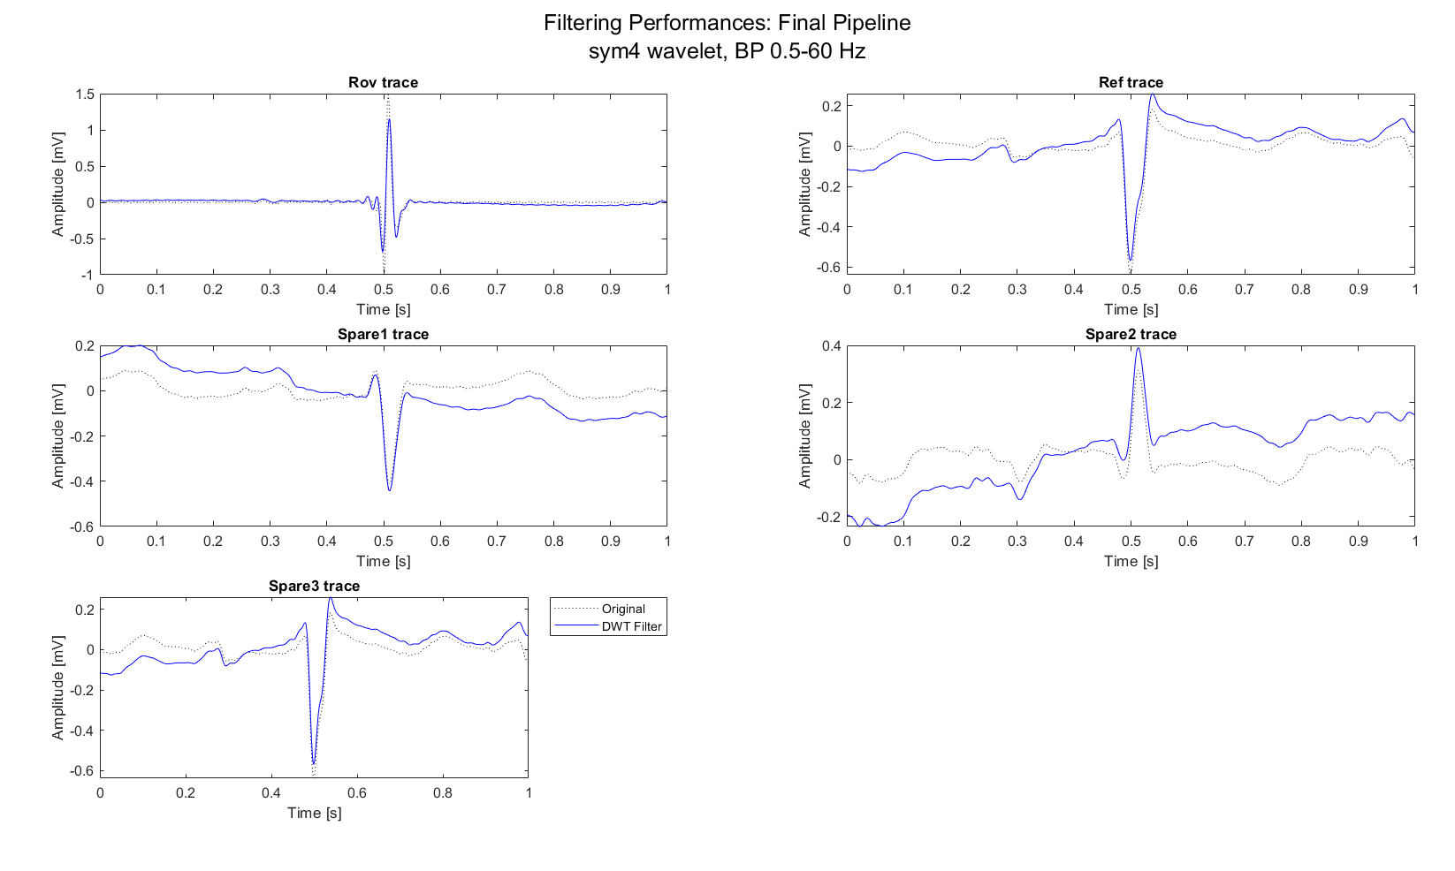
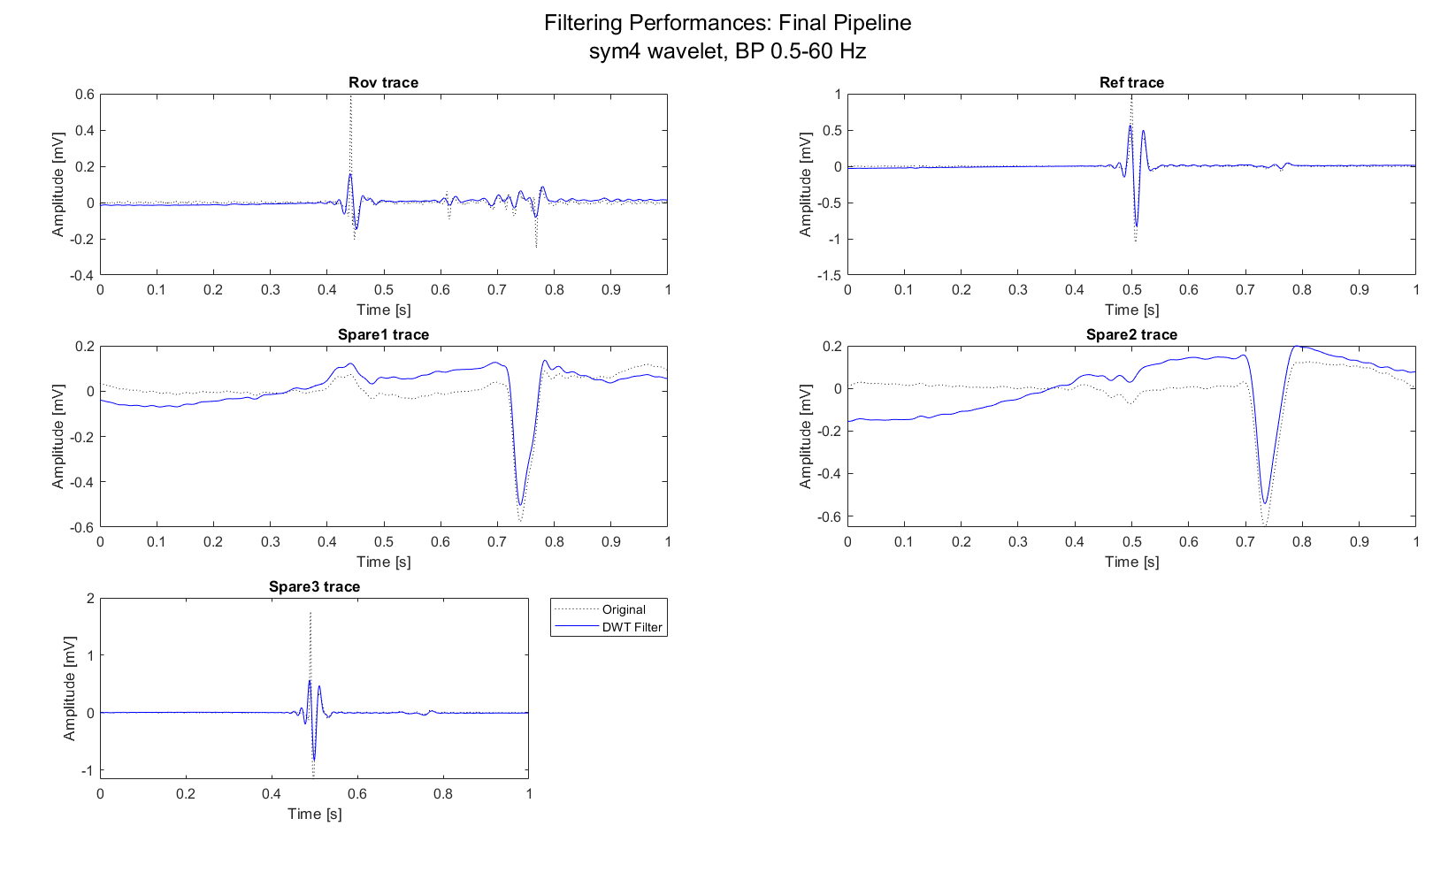
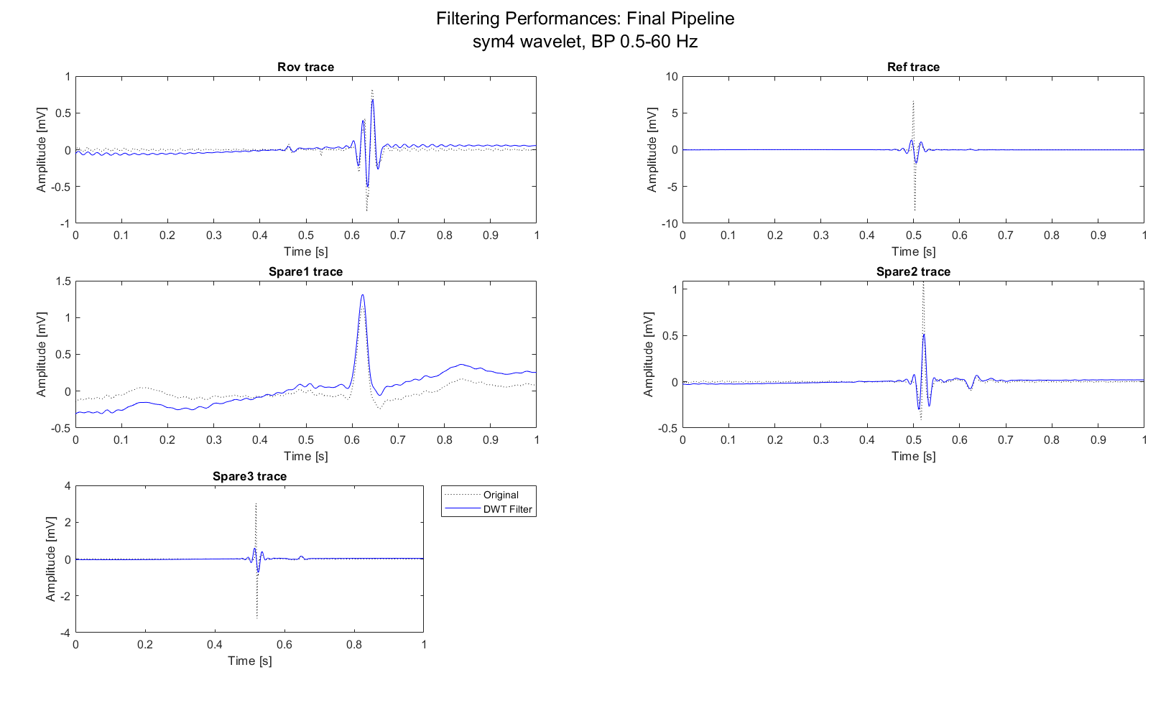
Preprocessing results: AVNRT data
Proposed method ensures the best compromise between noise removal and signal conservation.
MAP C, sub-1, record example
MAP C, sub-7, record example
MAP C, sub-8, record example
Moreover:
Zero-phase ensures the preservation of peaks location
Important peaks (A-H-V) preserved
Another preprocessing step could be normalizing data (i.e., min-max scaling) to make them comparable.

Slide 9
Outline
Recap of objectives so far
Signal preprocessing
Spectrum estimation
Signals alignment
Possible features of Rov Signals
Conclusions

Slide 10
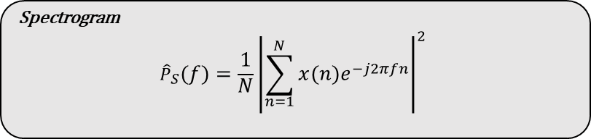
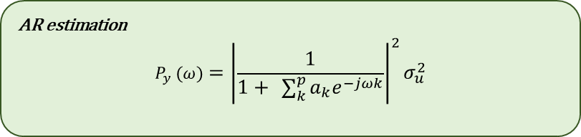
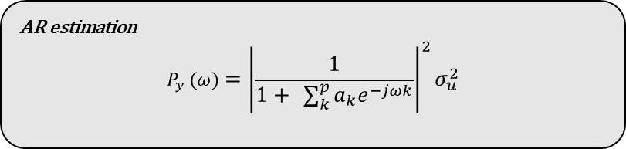
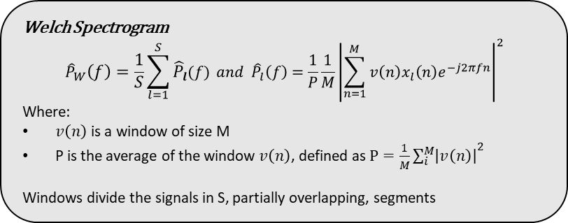
Spectrum estimation
Spectrum estimation can be done following different strategies:
Parametric strategies: i.e., AR estimation
Non-Parametric Strategies: i.e., Spectrogram or Welch estimation
AR spectrum estimation is not so much used in literature, but has important advantages:
Fast and easy application
Consistent and not windowed estimation of the spectrum
And at the same time some attentions:
Require a zero-mean signal as input of the estimator of the model
Spectrum estimation results depends on the AR coefficients estimator [3,4]
LS estimator has the best performance, together with Burg estimation, while Yule-Walker require high order models
Order choice is crucial: the model should represent well the signal
Optimal order was found between 8 and 20 in previous studies [3,4]
AR estimation
$$P_{y} (ω)={\left|\frac{1}{1+ \sum_{k}^{p}{a_{k}e^{−jωk}}}\right|}^{2}σ_{u}^{2}$$
AR estimation
$$P_{y} (ω)={\left|\frac{1}{1+ \sum_{k}^{p}{a_{k}e^{−jωk}}}\right|}^{2}σ_{u}^{2}$$
Spectrogram
$${\hat{P}}_{S}\left(f\right)=\frac{1}{N}{\left|\sum_{n=1}^{N}{x\left(n\right)e^{−j2πfn}}\right|}^{2}$$
DWT thresholding and BP filter
AR order estimation using nAIC criterion
AR spectrum estimation using LS estimator
Signal
Welch Spectrogram
$${\hat{P}}_{W}\left(f\right)=\frac{1}{S}\sum_{l=1}^{S}{{\hat{P}}_{l}(f)} and {\hat{P}}_{l}\left(f\right)=\frac{1}{P}\frac{1}{M}{\left|\sum_{n=1}^{M}{v\left(n\right)x_{l}\left(n\right)e^{−j2πfn}}\right|}^{2}$$
Where:
$v\left(n\right)$ is a window of size M
P is the average of the window $v\left(n\right)$, defined as $P=\frac{1}{M}{\sum_{i}^{M}{\left|v\left(n\right)\right|}}^{2}$
Windows divide the signals in S, partially overlapping, segments
3. Übeyli, Elif Derya, Dean Cvetkovic, and Irena Cosic. "AR spectral analysis technique for human PPG, ECG and EEG signals." Journal of Medical Systems 32 (2008): 201-206.
4. Nayak, Jagadish, et al. "AR modeling of heart rate signals." 2004 IEEE Region 10 Conference TENCON 2004.. IEEE, 2004.

Slide 11
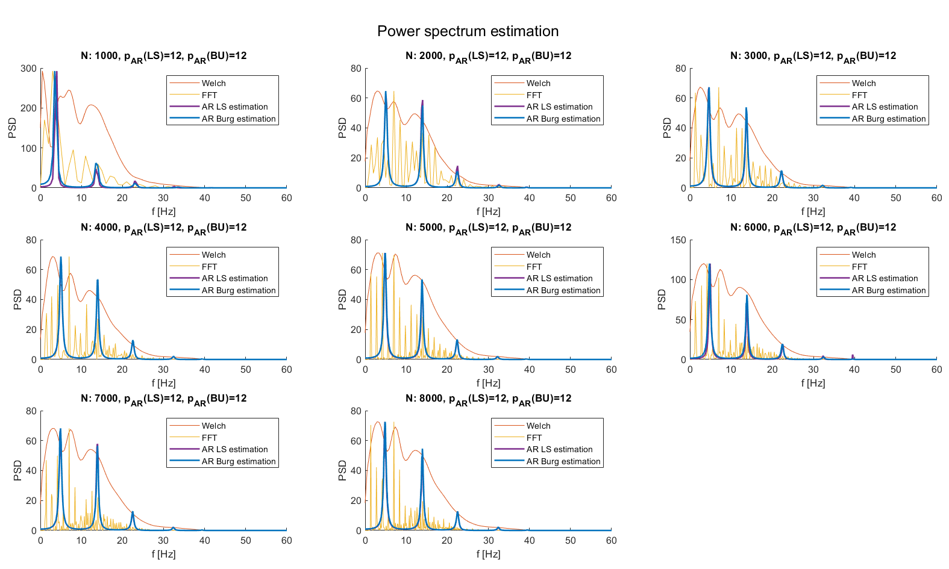
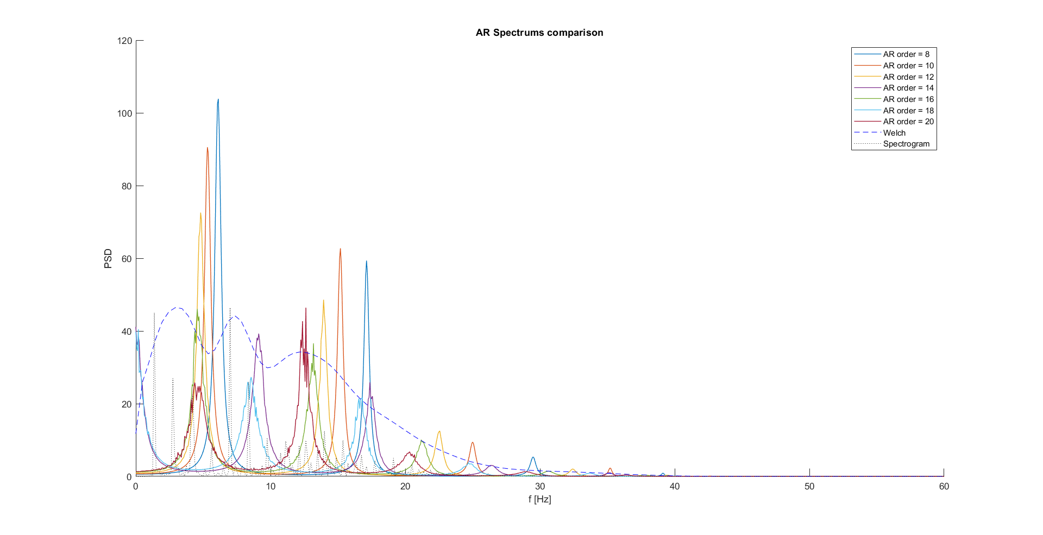
Spectrum estimation results: External data
The proposed spectrum estimation pipeline has been tested on well-know external data (didactical) and compared with the more used Spectrogram and Welch spectrogram.
Each subplot correspond to a spectrum evaluation of a HF noise corrupted signal with an increased number of points (i.e., beats) filtered with the proposed pipeline.
Burg and LS estimators converge, but AR spectrums, Welch spectrums and spectrograms does not lead to comparable results.
AR estimation seems to underestimate the signal, thus AR spectrum peaks are not aligned with the Welch ones.
Moreover, by changing the order, AR spectrum peaks moves, leading to the conclusion that AR spectral estimation does not provide satisfactory results.
Spectrum estimation is still an open problem to be investigated in the future.
LS estimation

Slide 12
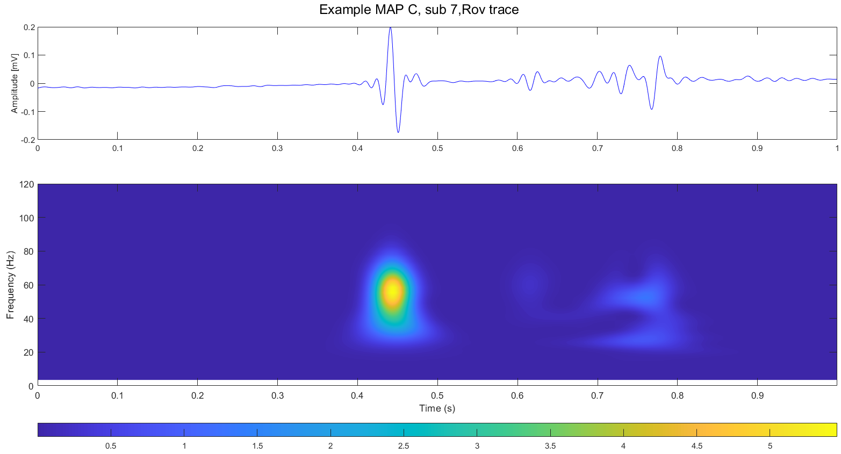
Spectrum estimation: comments
Now a dilemma arises:
On one hand, is known that spectral estimation could leave important insights on the data characteristics
On the other hand, AR spectrum estimation doesn’t improve results of Spectrogram and Welch Spectrogram
Moreover, Welch spectrogram still has the problems of non-parametric spectrum estimation
So, are there other methods that can be used?
Many studies use DWT features as descriptors of the frequency behavior of ECG signals [5,6]
Other uses even 2-D representations of DWT, i.e., scalograms [7]
Atrial
Ventricular
His’ bundle
5. P. deChazal, M. O’Dwyer, e R. B. Reilly, «Automatic Classification of Heartbeats Using ECG Morphology and Heartbeat Interval Features», IEEE Trans. Biomed. Eng, lug. 2004
6. S. Faziludeen e P. V. Sabiq, «ECG beat classification using wavelets and SVM», in 2013 IEEE CONFERENCE ON INFORMATION AND COMMUNICATION TECHNOLOGIES, apr. 2013, pp. 815–818
7. Y. D. Daydulo, B. L. Thamineni, e A. A. Dawud, «Cardiac arrhythmia detection using deep learning approach and time frequency representation of ECG signals», BMC Med Inform Decis Mak, vol. 23, fasc. 1, p. 232, ott. 2023

Slide 13
Outline
Recap of objectives so far
Signal preprocessing
Spectrum estimation
Signals alignment
Possible features of Rov Signals
Conclusions

Slide 14
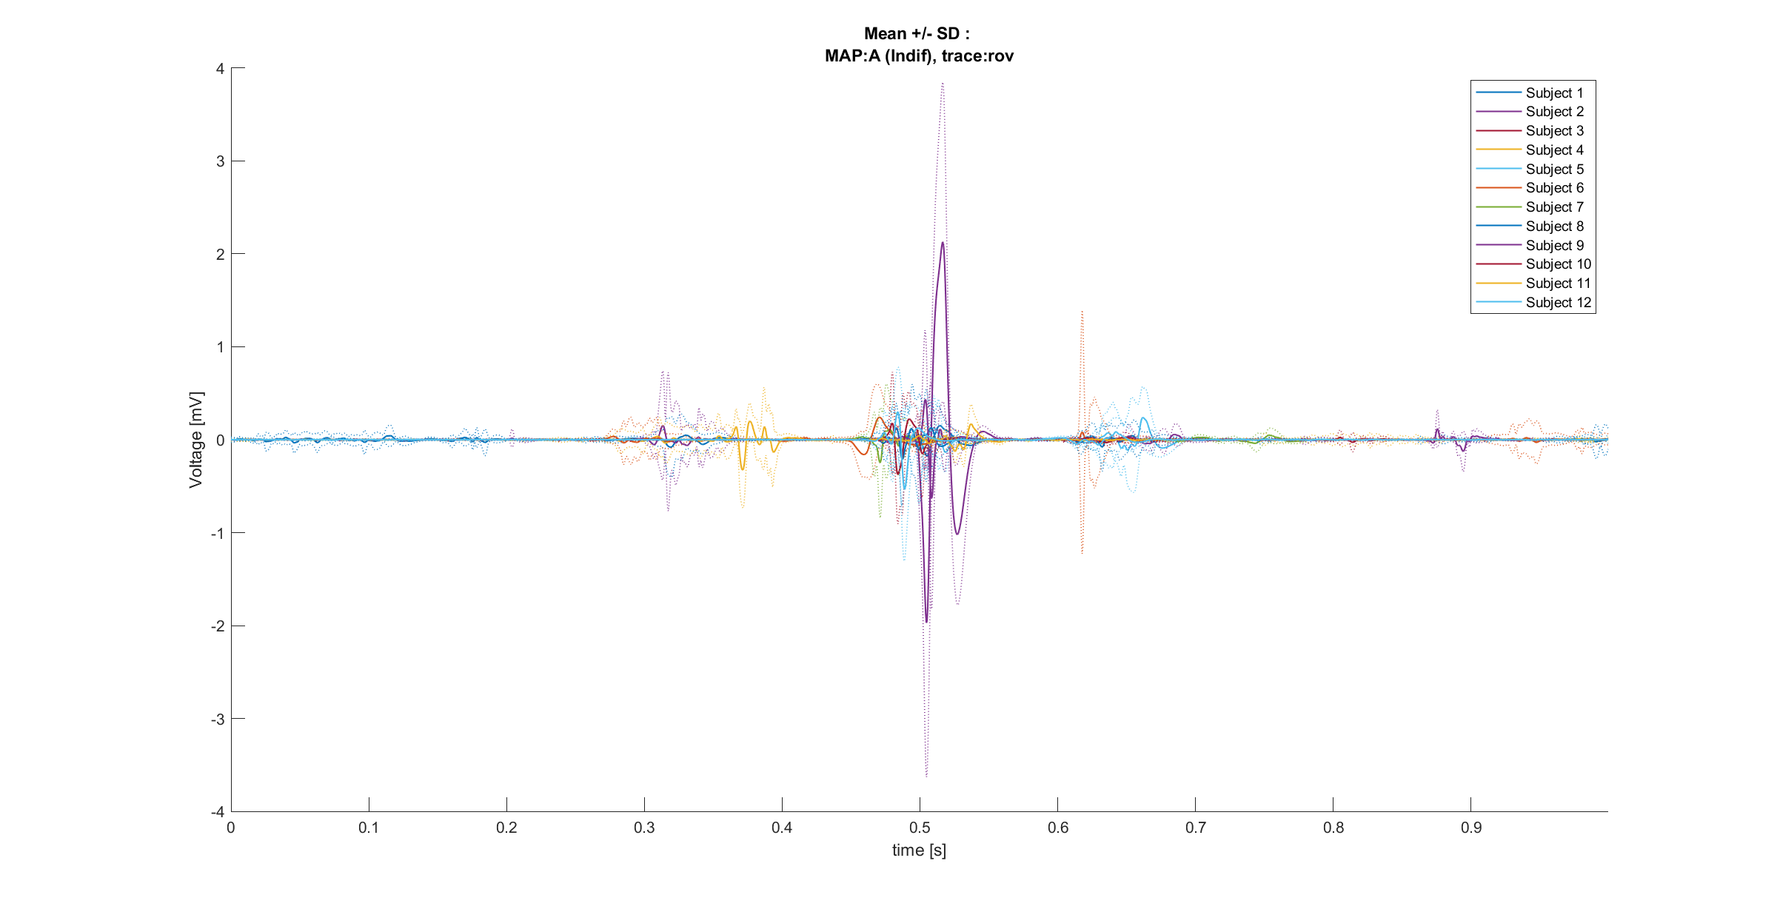
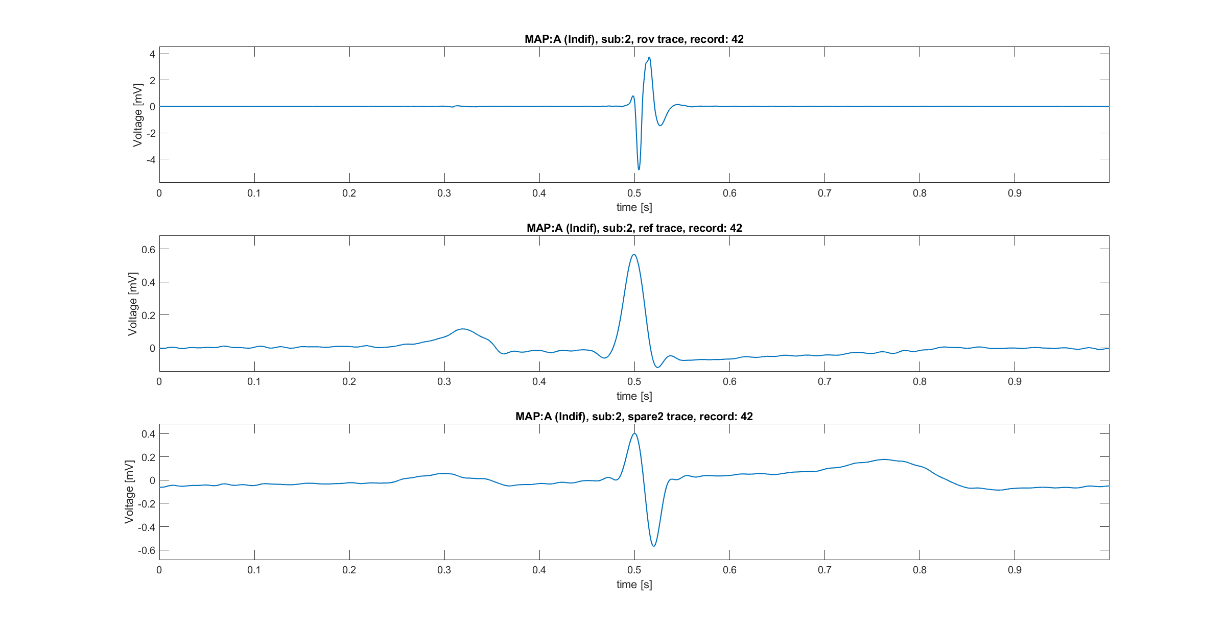
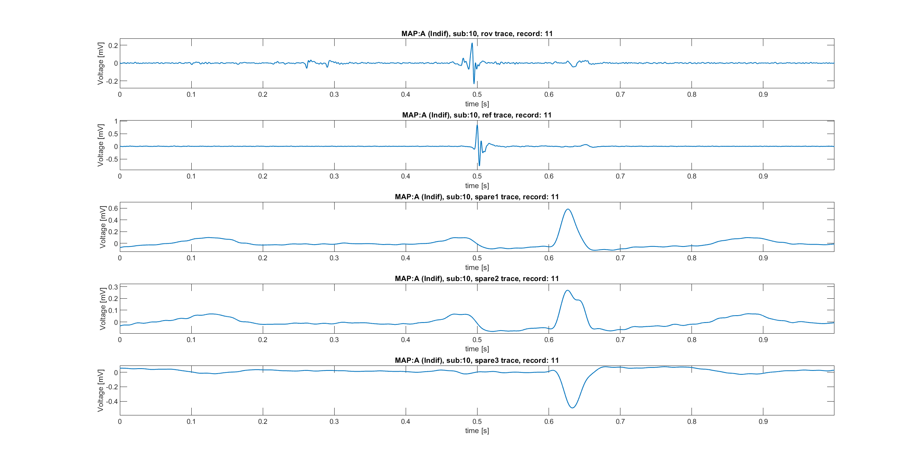
Alignment necessity
Alignment was found to be necessary to build a population dataset. In fact:
Between subjects, there are differences into the peak’s alignment
Localize correctly atrial, ventricular and His conduction is fundamental
The key idea is aligning the Rov trace respect to a QRS. Presumably, the Ref trace should play the role of trace against which align.
But:
Reference traces does not seem to contain always a QRS
In fact, there are Ref signals aligned respect to the atrial component of the Rov trace and spare traces
Reference traces, as said in previous meetings, should be the same as spare 1 traces, but this is not true (or at least it is just for subjects 2 and 4)
Is it possible that the QRS is recorded at least inside one spare trace?
Atrial? Ventricular?
Atrial
Ventricular

Slide 15
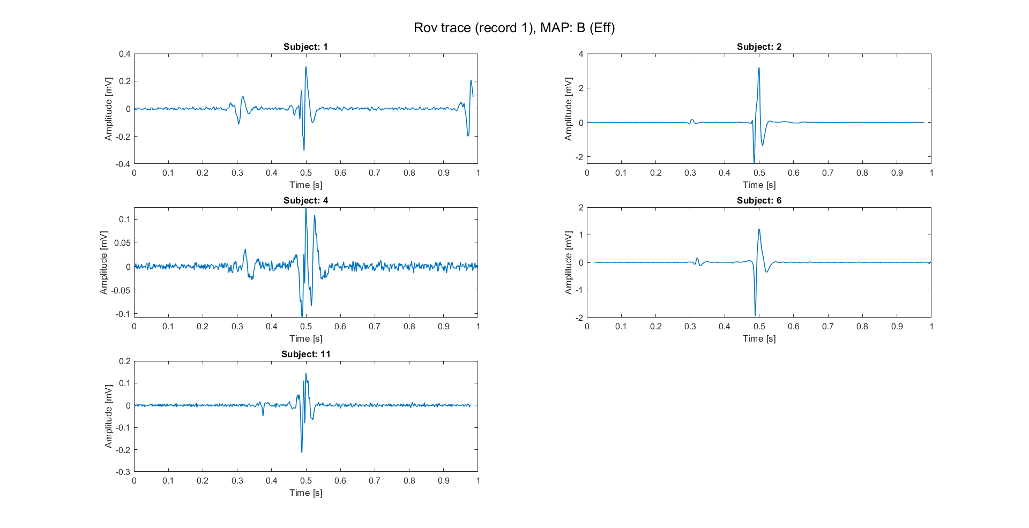
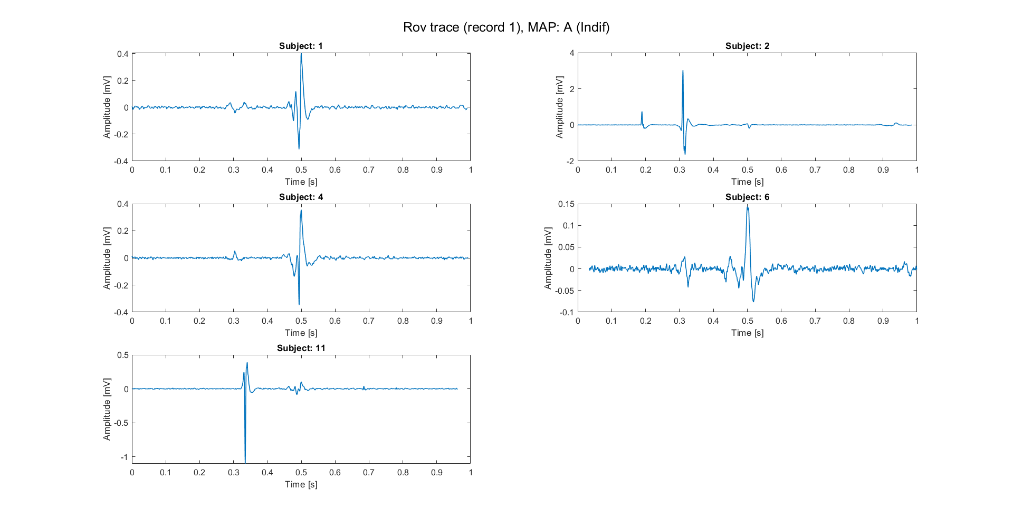
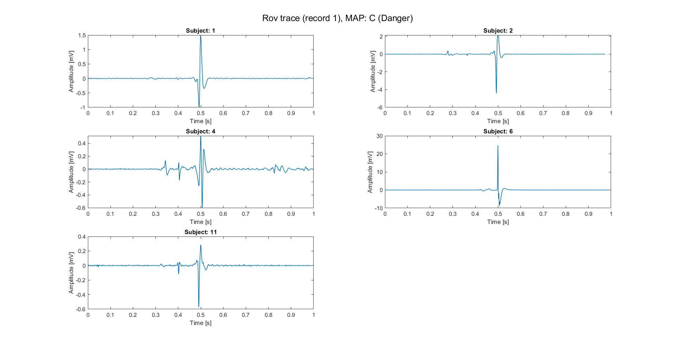
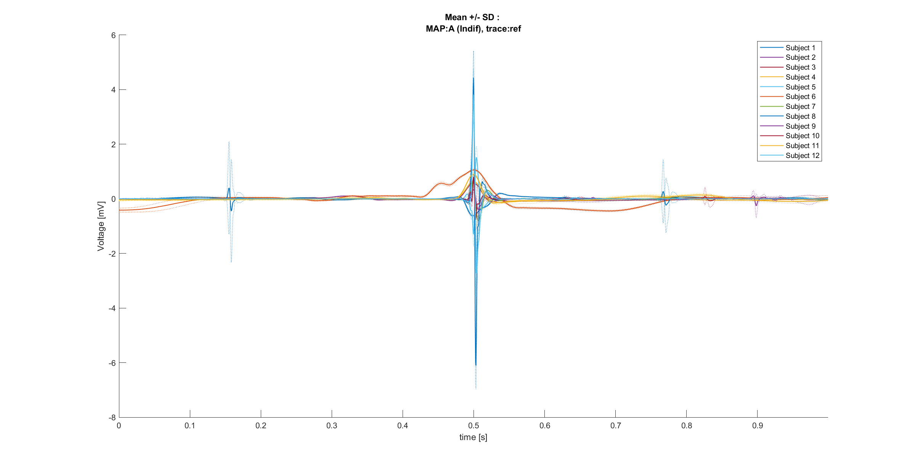
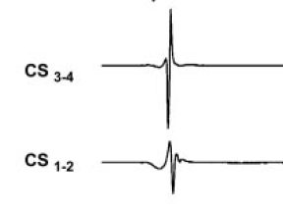
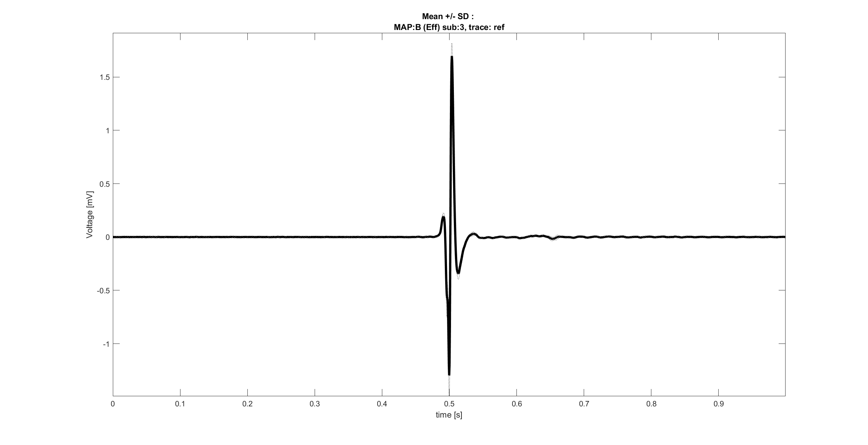
Alignment: open questions
It’s now necessary answer to some crucial questions:
Is it possible that reference traces are traces without the QRS? E.g., CS signal, used to localize the atrial activity [8]
Are the reference traces preprocessed by align them respect to 0.5 seconds?
Which is the nature of Spare traces? E.g., aV derivations, Lead I-II-III, other catheter signals.. [8]
Once answered to these questions, it could be possible building a population dataset, where all traces have a certain component (e.g., the ventricular conduction) aligned respect to a common point (e.g., 0.5 seconds).
Here, examples of aligned traces are reported. These traces are related to subjects in whom the ref trace presented a clear QRS (sub: 1,2,4,6,11).
8. Yousra Ghzally, Intisar Ahmed, e Gregg Gerasimon, Catheter Ablation, 2023 Jul 30., vol. StatPearls. in StatPearls [Internet], vol. StatPearls. Treasure Island (FL): StatPearls Publishing, 2024. [Online].

Slide 16
Outline
Recap of objectives so far
Signal preprocessing
Spectrum estimation
Signals alignment
Possible features of Rov Signals
Conclusions

Slide 17
Next step: feature extraction
Rov signals
Morphological features (time domain)
Points of the signal, even sub-sampled [9]
Fragmentation (number of peaks of the signal) [10]
PCA/ICA representations of the signal [9]
Filter and normalize
Alignment respect to a common point
Morphological features (Frequency domain)
Mean, variance, energy of DWT coefficients on different levels of decomposition [9]
Relative power of PSD on fixed sub-bands [10]
PCA/ICA representations of frequency domain features [9]
Feature extraction on Rov records
Label
Map A, Map B, Map C
9. E. J. D. S. Luz, W. R. Schwartz, G. Cámara-Chávez, e D. Menotti, «ECG-based heartbeat classification for arrhythmia detection: A survey», Computer Methods and Programs in Biomedicine, vol. 127, pp. 144–164, apr. 2016.
10. G. Baldazzi, M. Orrù, G. Viola, e D. Pani, «Computer-aided detection of arrhythmogenic sites in post-ischemic ventricular tachycardia», Sci Rep, vol. 13, fasc. 1, p. 6906, apr. 2023

Slide 18
Outline
Recap of objectives so far
Signal preprocessing
Spectrum estimation
Signals alignment
Possible features of Rov Signals
Conclusions

Slide 19
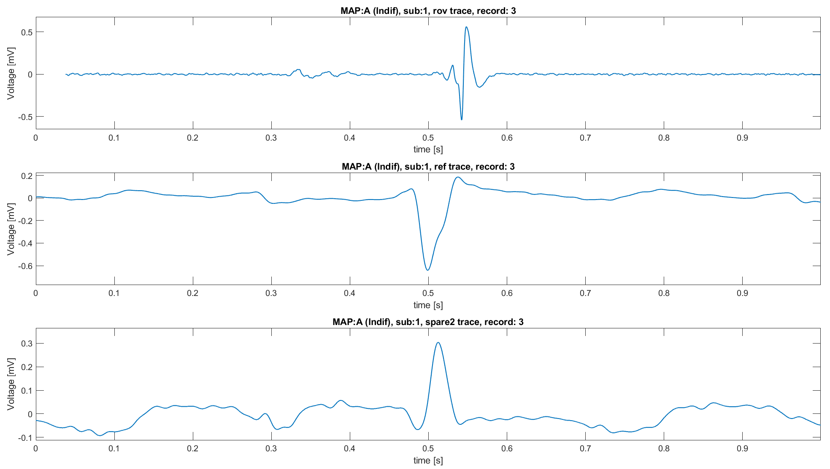
Conclusions
So far, some progress has been made on understanding the signals we have:
Data require preprocessing. While filtering is necessary, it is possible that rescaling will also be necessary in the future.
Spectral analysis should be done with different methods respect to the traditional ones
Alignment it’s necessary to build a population dataset, but requires additional information
Once clarified these aspects, there’s another open question: why are there signals afferent to MAP A with clearly characteristics of MAP B?
Noise and bad positioning of the electrode
Necessity of positional information to completely characterize the signal (i.e., the heart surgeon knows where he’s located with the electrode and uses this information to “classify” the signal)
Since the classification is done a posteriori (knowing the ablation result), it is possible that the signal may be afferent to a certain MAP even though its characteristics do not suggest the classification assigned to it
Why?

Slide 20
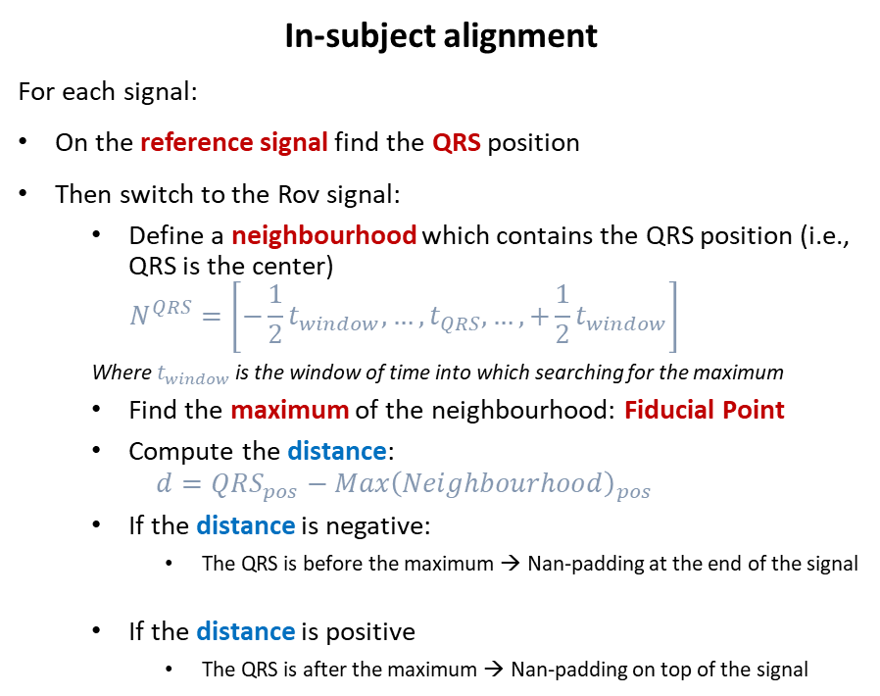
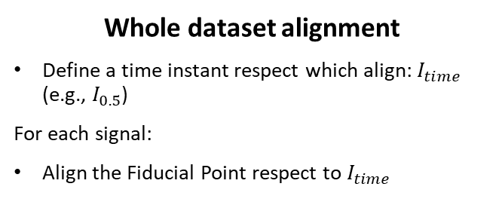
Traces alignment pipeline
In-subject alignment
For each signal:
On the reference signal find the QRS position
Then switch to the Rov signal:
Define a neighbourhood which contains the QRS position (i.e., QRS is the center)
$$N^{QRS}=\left[−\frac{1}{2}t_{window},…,t_{QRS},…,+\frac{1}{2}t_{window}\right]$$
Where $t_{window}$ is the window of time into which searching for the maximum
Find the maximum of the neighbourhood: Fiducial Point
Compute the distance:
$$d=QRS_{pos}−Max{\left(Neighbourhood\right)}_{pos}$$
If the distance is negative:
The QRS is before the maximum → Nan-padding at the end of the signal
If the distance is positive
The QRS is after the maximum → Nan-padding on top of the signal
Whole dataset alignment
Define a time instant respect which align: $I_{time}$ (e.g., $I_{0.5}$)
For each signal:
Align the Fiducial Point respect to $I_{time}$
Hyperparameter: Time window: 0.1 s

